Slide 1





Redesigning AI Fact-Checking
Sean Lee-Wah - 221344163
Robert Portman - 213742200
Angelos Tselios - 221616826
Yathharthha Kaushal - 221116678
Raad Alkassim - 221596788
Notes:
Robert Portman
Hello, and thank you for joining us. Today, we are presenting the technical report titled Redesigning AI Fact-checking: from verdict to insight.
This report explores the need to change how AI models present the validity of information, shifting from blunt conclusions to nuanced, easily interpretable outputs.

Slide 2
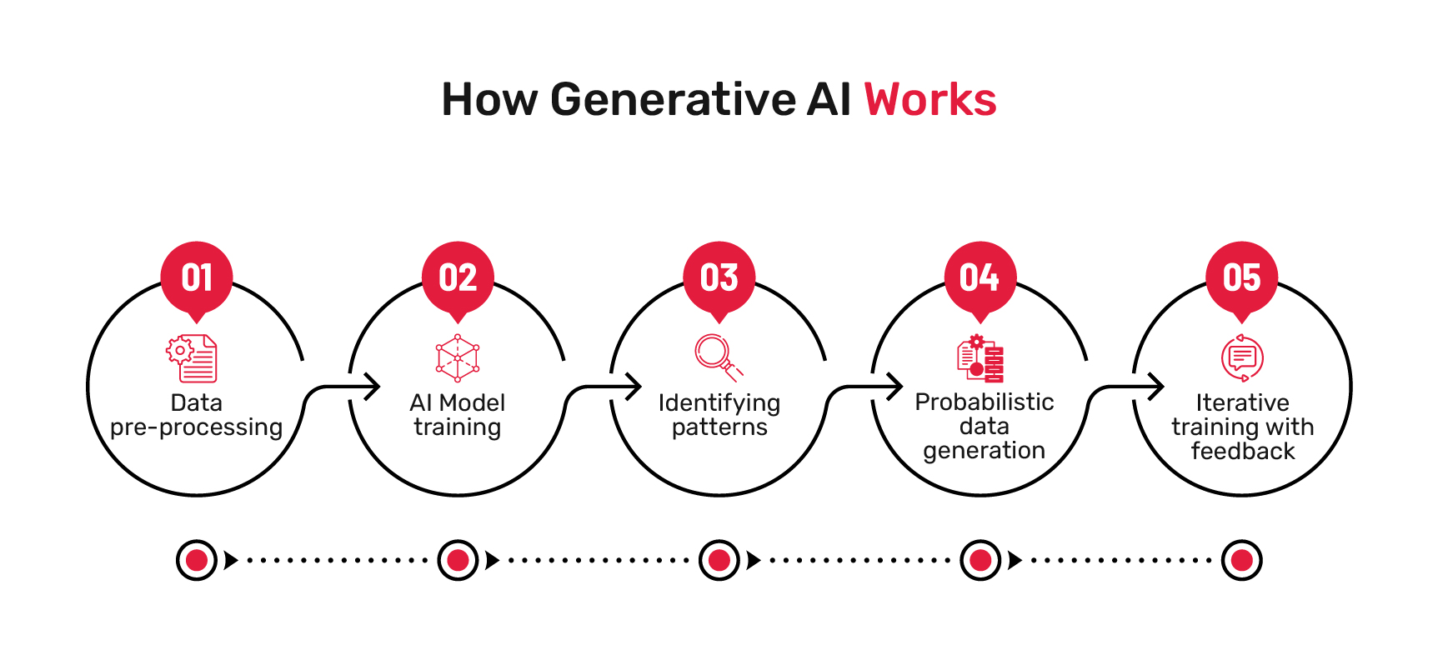
What is Generative AI?
Subset of Artificial Intelligence - Produces new outputs based on analyzing large datasets[10].
Figure 1. Method of how AI models are developed and trained [10]
Robert Portman
Notes:
Robert Portman
Generative AI is a subset of Artificial intelligence that produces novel outputs by analysing large datasets for patterns. This can include relating new ideas to existing concepts as well as statistical analysis.

Slide 3
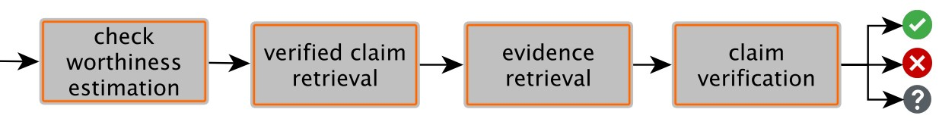
The Current State of AI Fact-Checking
-Clearly states opinion on information validity
-Replaces human critical thinking
-AI errors unchecked (hallucinations and overgeneralization)
-Premium on time at expense of accuracy
Figure 2. Sequential AI fact-checking method [5]
Robert Portman
Notes:
Robert Portman
Presently, AI models used in fact-checking will state whether information sources are reliable. While this can effectively filter out some sources of misinformation, it incentivizes users to depend on AI over critical thinking. This sets a dangerous precedent as AI models can present false information or generalize findings outside their relevant scope.

Slide 4
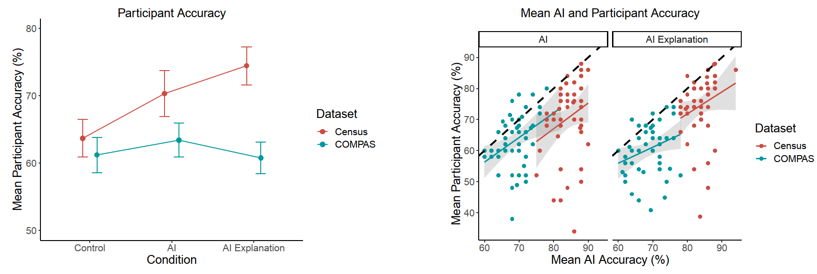
The Proposed Solution
-Change in methodology: From decision-maker to information provider
-AI improves decision making [11]
-Users do not consider explanations provided [11]
Figure 3. AI assistance boosts decision-making accuracy compared to controls [11]
Figure 4. AI explanations on decision making do not improve choice accuracy [11]
Robert Portman
Notes:
Robert Portman
A change in how AI presents information is required to address these concerns. While some AI models provide explanations when prompted, studies have shown that users often default to AI regardless of its quality [2].
This report suggests AI models should be retrained to provide impartial analysis of information for the user to interpret. This places responsibility on the Individual to critically analyze AI outputs and acts as an additional method to detect AI errors.

Slide 5

Limitations of Scope
A general guideline (not a manual) to AI growth and development
AI-generated image created by ChatGPT, August 2025. [12]
Robert Portman
Notes:
Robert Portman
It is important to note that while this presentation describes needed changes, it does not examine every AI fact-checker. Nor does it suggest specific design methodologies that can be implemented.
Instead, it provides guidelines for future AI development that optimize independent judgment.

Slide 6
Problem
People don't want AI to dictate truth to them
People are often unaware of their own information bubble
Can reenforce biases
Raad Alkassim

Slide 7
Problem Statement
How can AI fact-checking change from giving verdicts to providing credible, diverse, and unbiased information that allows for users to think critically?
Raad Alkassim

Slide 8


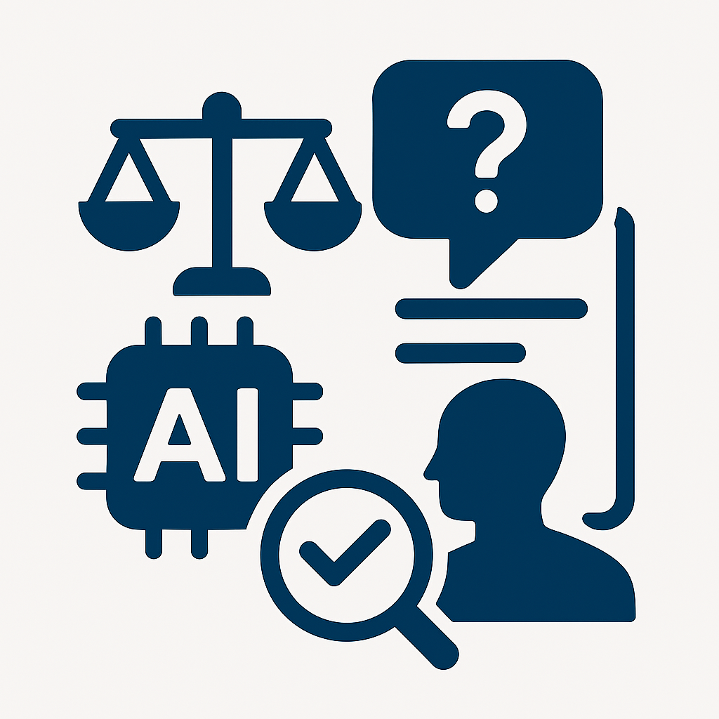


Main Content
Misinformation and the need for fact checking
Benefits of AI in fact checking
Ethical and social implications
Limitations and challenges
Yathharthha K
Notes:
Yathharthha K
Let’s now move into the main content of the report, which is structured around four key areas that explore the relationship between fact-checking and artificial intelligence.
We begin with Misinformation and the need for fact-checking, where we examine the scale and impact of misinformation in digital spaces, and why robust verification mechanisms are essential.
Next, we explore the Benefits of AI in fact-checking, highlighting how AI can enhance the speed, scalability, and accuracy of information verification.
Following that, we address the Limitations and challenges—this section outlines the technical, operational, and ethical constraints that affect the reliability and adoption of AI-driven fact-checking systems.
Finally, we consider the Ethical and social implications, discussing how these technologies influence public trust, privacy, and the broader societal discourse around truth and accountability.
Together, these sections provide a comprehensive overview of both the potential and the complexities of integrating AI into fact-checking workflows. Let’s begin with the first section: Misinformation and the need for fact-checking

Slide 9
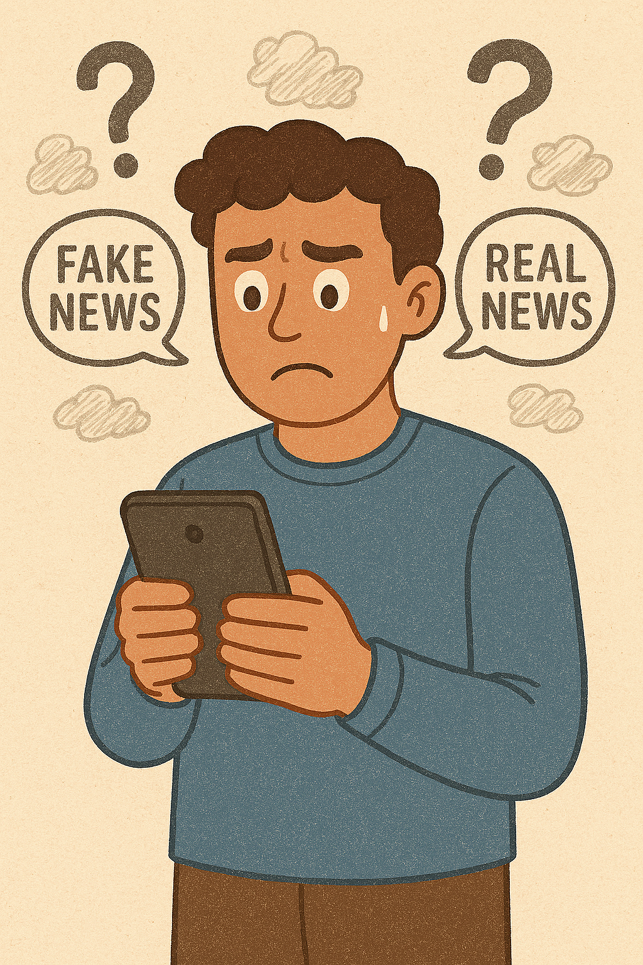
The Need for Fact-Checking
A lot of Canadians are finding it difficult to spot misinformation
People don’t trust online information
People need a better way to fact check
AI-generated image created by Microsoft Copilot, August 2025. [13]
Yathharthha K
Notes:
Yathharthha K
Just in 2023, 43% of Canadians believed it was getting harder to differentiate between real and fake news online
For example, 64% of people would not trust information posted on social media, indicating the need to fact check these posts

Slide 10
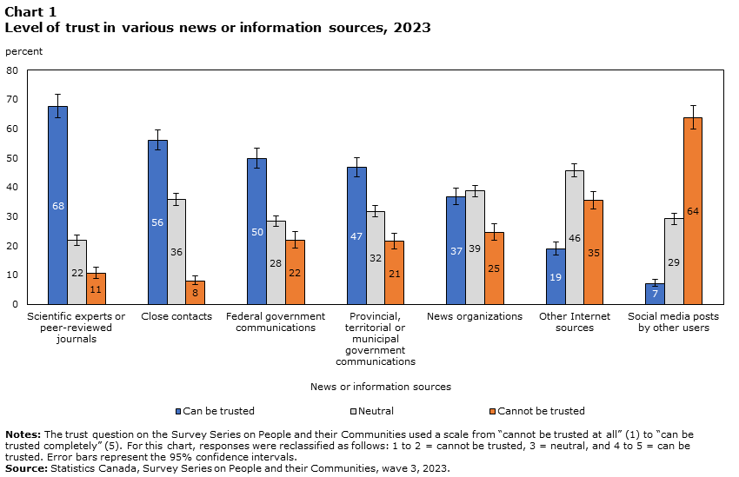
The Need for Fact-Checking
Can be trusted
Neutral
Cannot be trusted
Figure 5: Survey done to see peoples trust from various different sources [2]
Yathharthha K
Notes:
Yathharthha K
Just in 2023, 43% of Canadians believed it was getting harder to differentiate between real and fake news online
For example, 64% of people would not trust information posted on social media, indicating the need to fact check these posts

Slide 11
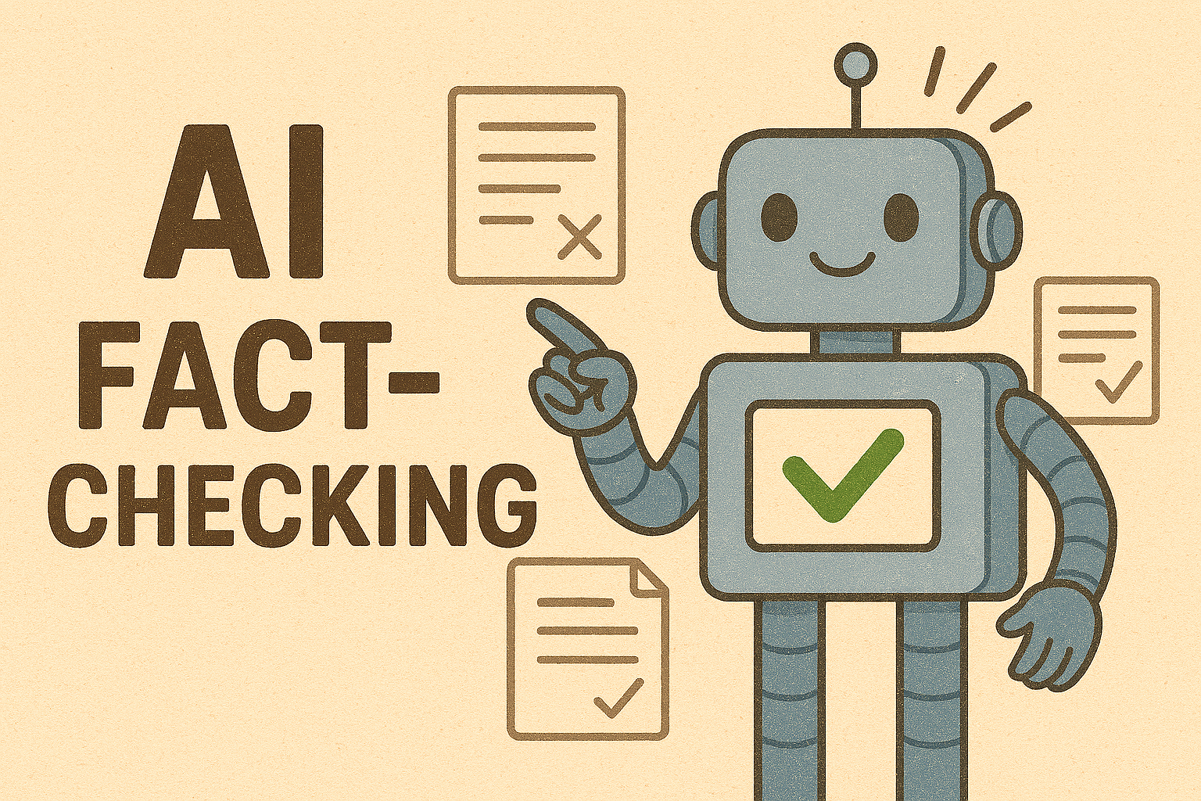
Benefits of AI
Fast information retrieval
Increased efficiency
Scalable across platforms
Accurate source identification
Saves time for human analysts
AI-generated image created by Microsoft Copilot, August 2025. [13]
Yathharthha K
Notes:
Yathharthha K
“AI brings speed and efficiency to fact-checking. It can instantly retrieve credible sources, saving time compared to manual searches.
This allows human analysts to focus on deeper analysis, while AI handles repetitive tasks.
It’s scalable, accurate in source selection, and integrates well with digital platforms—making it a powerful tool in modern fact-checking.”

Slide 12
Limitations and Challenges
Verdict-Based Responses
Respond without definitive verification
Bias in AI Systems
Biased datasets
Biased Algorithms
Impact on Users
Wrongly made decisions
Unintended consequences from decisions
Yathharthha K
Notes:
Yathharthha K
Limitations & Challenges of AI in Fact-Checking
Verdict-Based Responses
AI may provide definitive answers without thorough verification.
Risk of spreading incorrect information.
Bias in AI Systems
Data Bias: Skewed or incomplete training data.
Algorithmic Bias: Patterns that favor certain outcomes.
Human Bias: Developer influence during model creation.
Impact on Users
Misinformation can lead to poor grades or reputational harm.
Especially critical in academic and professional contexts.
Mitigation Strategies
Use diverse datasets.
Regular algorithm audits.
Inclusive development teams.

Slide 13
Ethical and Social implications
Authority & Trust
Use of AI for fact checking may reduce trust
Bias in Source Selection
Biased towards some sources
Credibility
Transparency & Accountability
Not enough clarity in AI reaching conclusions
Social Impact
Users may cite incorrect information
Can damage personal credibility
Raad Alkassim
Notes:
Authority & Trust
"AI systems are increasingly making judgments about what's true or false. This can make users uncomfortable, especially if they feel the AI is acting as an authority rather than a tool."
"This shift can erode trust, as users may prefer to interpret information themselves."
Bias in Source Selection
"AI may favor certain sources over others due to its training data or algorithmic design."
"Even if the chosen sources aren't less credible, this preference can still skew the information presented."
Transparency & Accountability
"Users often don’t understand how AI reaches its conclusions, which raises accountability concerns."
"Even when the information is accurate, lack of transparency can lead to skepticism."
Social Impact
"If users unknowingly share incorrect information from AI, they may be seen as dishonest or unreliable."
"This can affect their personal and professional credibility."
Solutions
"To address these concerns, AI models should present a range of credible sources."
"This empowers users to make informed decisions rather than relying solely on AI verdicts."

Slide 14





Discussion and/or Results
OVERVIEW OF THE PROPOSED SOLUTION
BENEFITS TO USERS AND PLATFORMS
RATIONALE AND JUSTIFICATION
COMPARISON TO CURRENT FACT-CHECKING MODELS
IMPLEMENTATION CONSIDERATIONS
Sean Lee-Wah
Notes:
Sean Lee-Wah
The 5 points being discussed for the proposed solution are:
- Overview
- Rationale and justification
- Implementation and considerations
- Benefits to its users and platforms
- Comparison to current AI fact-checking models

Slide 15
Overview of the Proposed Solution
User question
- Information-based over verdict-based model
- Retrieves and relays credible information
- AI would act as a guide for user
- User makes their own decisions
AI searches for resources
AI determines credibility
AI summarizes and outputs information to user
AI answers any questions user has for the given info, and addresses requests
Figure 6: A flowchart describing how the proposed model will fact-check for the user
Sean Lee-Wah
Notes:
Sean Lee-Wah
- AI models will move from decision-based to information based
- Find and pass on information to the user
- This model allows for users to make their own decisions on the matter
- The user can ask the AI any questions
- AI will guide the user based on their questions

Slide 16
Rationale and Justification
- Users dislike being told what is true or false [3]
- Proposed model would provide sources for user to interpret
- Respects user opinions
Sean Lee-Wah
Notes:
Sean Lee-Wah
- Software engineer Ben Fletcher at IBM received feedback on AI fact-checking model
- He found that users dislike being told what is “true” or “false” by AI
- The proposed model would instead provide sources, avoiding this issue
- This would respect user opinions and prevent conflict

Slide 17
Implementation Considerations
- Capability of AI to find credible sources
- Clear display of information
- Adjust to preferences of user
Sean Lee-Wah
Notes:
Sean Lee-Wah
- The AI model must be able to find information only from credible sources that is trustworthy and correct
- Information should be presented in a way that is easy for user to understand (e.g. bullet points and summaries)
- The model should be able to adjust to any preferences the user prefers (e.g. summarizing certain parts)

Slide 18
Benefits to Users and Platforms
- Provides users with critical thinking and decision making skills
- Allows for many viewpoints
- Decrease the bias found in AI
Sean Lee-Wah
Notes:
Sean Lee-Wah
- If users interpret information themselves, they will be able to improve their critical thinking and decision making skills
- There would be more opinions on the matter (e.g. encourages innovative solutions)
- AI will contain less bias if user is interpreting the information themselves

Slide 19
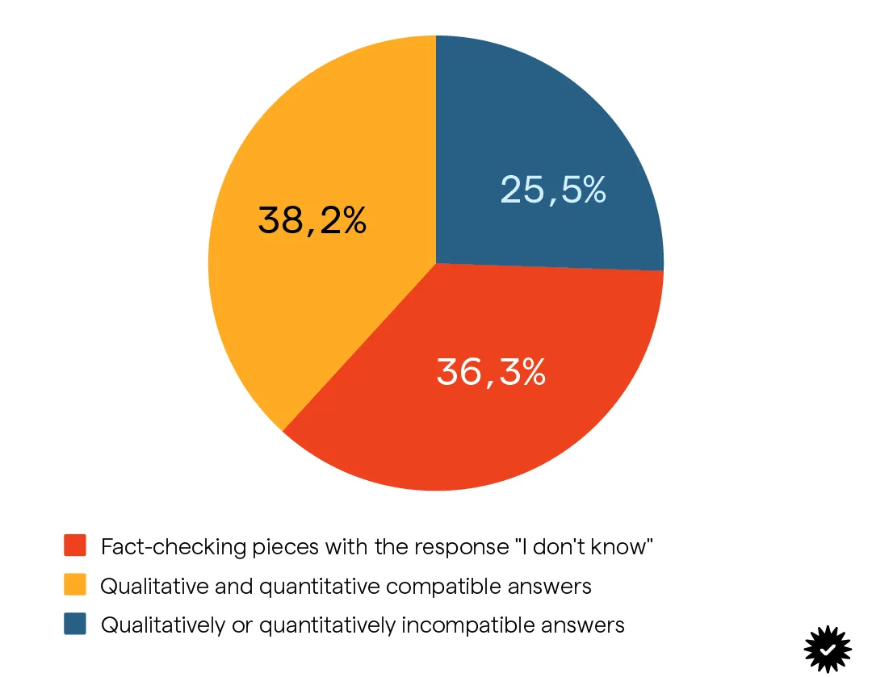
Comparisons to Current Fact-Checking Models
- ChatGPT could only answer 63.7% of questions [9]
- 38.2% of answers were correct [9]
Figure 7: Experiment where ChatGPT answered 104 questions, and answers were analyzed [9]
Angelos Tselios
Notes:
Angelos Tselios
- An experiment was conducted, where ChatGPT was asked 104 questions
- It could only answer 63.7% of the questions
- Of the 63.7%, only 38.2% of questions were answered correctly quantitatively and qualitatively

Slide 20
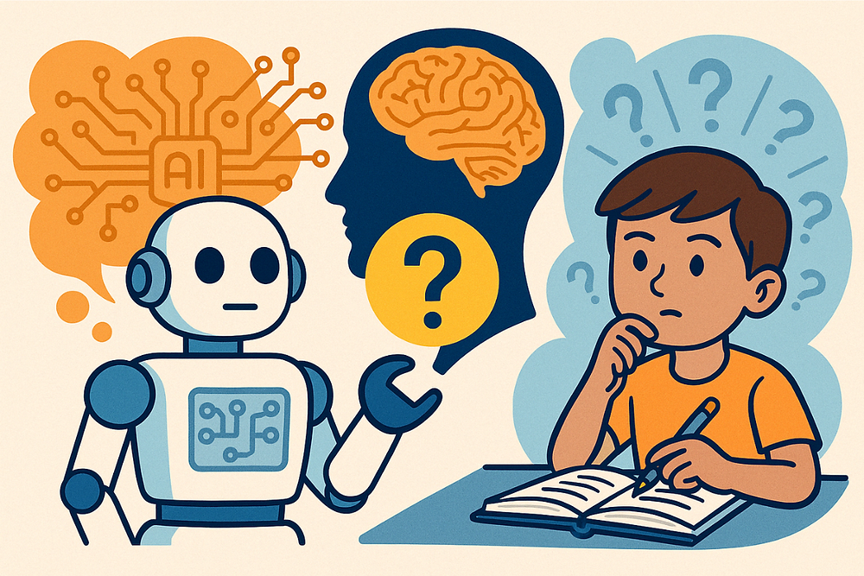
Conclusion
Traditional AI models can mislead more than help.
Users want sources, not verdicts.
Proposed model promotes informed decision-making.
Real-world use requires transparency and adaptability.
A redesigned AI can support, not replace, critical thinking.
Angelos Tselios
Notes:
Angelos Tselios
-Traditional AI models aren't reliable fact-checkers they can hallucinate or overstate confidence.
-Emphasize that users don’t want AI to decide for them; they want information to make their own calls.
-Our solution flips the model: AI acts as an assistant, not a judge.
-Point out this shift helps users develop critical thinking, not rely on AI blindly.
-Wrap up this slide by saying: trust in AI increases when users stay in control.

Slide 21
Conclusion
Empowering users with context, not control.
Bridging trust between AI tools and human judgment.
Next step: testing implementation and user response.
Angelos Tselios
Notes:
Angelos Tselios
-Talk about the importance of transparency, users should always know where info comes from.
-Stress that AI should be adaptive to different user needs, not a one-size-fits-all.
-Say that our model aims to rebuild trust between AI and human judgment.
-Close by noting that the next step is implementation, testing it in real-world use cases and seeing how people interact with it.

Slide 22
References
[1] S. Cao and C. Huang, “Understanding User Reliance on AI in Assisted Decision‑Making”, in Proc. ACM Hum.–Comput. Interact., vol. 6, CSCW2 Article 471, Nov. 2022, 23 pp., doi: 10.1145/3555572. [Online].
Available: https://dl.acm.org/doi/pdf/10.1145/3555572
[2] H. Bilodeau and A. Khalid, "The spread of misinformation: A multivariate analysis of the relationship between individual characteristics and fact-checking behaviours of Canadians", Statistics Canada, 2024. [Online]. Available: https://www150.statcan.gc.ca/n1/pub/22-20-0001/222000012024003-eng.htm.
[Accessed: 20-Jul-2025].
[3] B. Lufkin, “50 Grand Challenges for the 21st Century", BBC Future, Mar. 31, 2017. [Online]. Available: https://www.bbc.com/future/article/20170331-50-grand-challenges-for-the-21st-century
[4] R. Wolfe and T. Mitra, “The Impact and Opportunities of Generative AI in Fact‑Checking”, in Proc. ACM Conf. Fairness, Accountability, and Transparency (FAccT ’24), Rio de Janeiro, Brazil, June 3–6, 2024, pp. 1531–1543. [Online]. Available: https://doi.org/10.1145/3630106.3658987
[5] P. Nakov, et al., “Automated fact‑checking for assisting human fact‑checkers”, arXiv, arXiv:2103.07769, Mar. 13, 2021. [Online].
Available: https://arxiv.org/pdf/2103.07769
Angelos Tselios
Notes:
Angelos Tselios
References used for the presentation

Slide 23
References
[6] D. Roselli, J. Matthews, and N. Talagala, "Managing Bias in AI", in Companion Proceedings of The 2019 World Wide Web Conference, San Francisco, CA, USA, 2019, pp. 1–2. [Online]. Available: https://dl.acm.org/doi/pdf/10.1145/3308560.3317590. [Accessed: 20-Jul-2025].
[7] KFF Health Misinformation Tracking Poll, “Most Who Use Artificial Intelligence Doubt AI Chatbots Provide Accurate Health Information”, KFF Health Misinformation Monitor, vol. 5, Aug. 15, 2024. [Online]. Available: https://www.kff.org/health-information-trust/press-release/poll-most-who-use-artificial-intelligence-doubt-ai-chatbots-provide-accurate-health-information/. [Accessed: 20-Jul-2025].
[8] G. Sharma, “How AI‑powered fact‑checking can help combat misinformation”, Ivy Exec, Jul. 15, 2024. [Online]. Available: https://ivyexec.com/career-advice/2025/how-ai-powered-fact-checking-can-help-combat-misinformation
[9] Z. Şahin and Y. A. Yılmaz, “Can ChatGPT be a reliable fact‑checker?”, Teyit, 27 Dec. 2023. [Online]. Available: https://en.teyit.org/teyitpedia/can-chatgpt-be-a-reliable-fact-checker [Accessed: Jul. 28, 2025].
Angelos Tselios
Notes:
Angelos Tselios

Slide 24
References
[10] Jaro Education, “What Is the Future of Generative AI?”, Jaro Education Blog, March 20, 2024. [Online]. Available: https://www.jaroeducation.com/blog/future-of-generative-ai/.
[11] Y. Alufaisan, L. R. Marusich, J. Z. Bakdash, Y. Zhou, and M. Kantarcioglu, “Does explainable artificial intelligence improve human decision‑making?,” in Proc. 35th AAAI Conf. Artificial Intelligence (AAAI‑21), 2021. [Online]. Available: https://ojs.aaai.org/index.php/AAAI/article/view/16819
[12] OpenAI, AI and Human Cooperating, image generated using DALL·E via ChatGPT [Online]. Available: https://chat.openai.com/
[13] Microsoft Copilot, AI assistance and image generation throughout presentation, generative AI tool used for content creation and design [Online]. Available: https://copilot.microsoft.com/
Angelos Tselios
Notes:
Angelos Tselios

